Slide 1
Presented By: Richa Shah Kishan Dungarani
Firebase

Slide 2
What is firebase?
It's basically middle ware that allows you do a number of things cross platform
Analytics
is a free and unlimited analytics tool to help you get insight on app usage and user engagement. No extra code needed, only console.
Cloud Messaging
Firebase Cloud Messaging lets you deliver and receive messages across platforms reliably.
Notifications
helps you re-engage with users at the right moment. No extra code needed, only console
Authentication
a key feature for protecting the data in your database and storage.
Realtime Database
lets you sync data across all clients in realtime and remains available when your app goes offline.
Cloud Firestore (new database, just out of beta)
Combines cloud database and functions together. Uses a scalable NoSQL cloud database to store and sync data.
Storage
lets you store and serve user-generated content, such as photos or videos. Firebase Storage is backed by Google Cloud Storage

Slide 3
Continue
Functions
Run your mobile backend code without managing servers
Hosting
provides fast and secure static hosting. No backend, but delivers .html,.css, etc files.
Remote Config
change the behavior and appearance of your app without publishing an app update.
App Indexing
With Firebase App Indexing, you can drive organic search traffic to your app, helping potential users of your app become your app’s biggest fans.
Dynamic Links
lets you pull users right to the content they were interested in, keeping them engaged and increasing the likelihood that they will continue to use the app.
Invites
Firebase Invites helps your users share your app with others. referral codes or share content from the app. Uses the Dynamic Links so links survive the install of the app. And do most of the work automatically.
AdWords
help you search potential users with online ads.
AdMob
provides easy and powerful ad monetization with full support in Firebase.

Slide 4
What is firebase?
Beta products
ML Kit
"Use machine learning to solve problems" Currently, it is just the Vision APIs for text recognition, face detection, barcode scanning, image labeling, and landmark recognition. But this would use the cloud based systems instead of just the device cpu.
A/B Testing
Let you optimize your app experience based on analytics. Change it for different demographics, make it different experience for say a teenage group verses a retired group. Without having to deploy two version of the app. Needs remote config.
Deploy a new feature to a group and evaluate the effect of the changes on app use.
Predictions
Uses remote config, providing a custom experience based on each of your users' predicted behavior.
You can use Predictions with the Notifications composer to deliver the right message to the right user groups.

Slide 5
Firebase console
Google has a number of "consoles".
These are webpages to control varying things.
Other Examples:
https://partner.android.com/things/console#/ android things
https://console.developers.google.com/apis/ for apis like maps
https://developers.google.com/beacons/dashboard/ for beacons
Firebase has it's own as well
https://console.firebase.google.com/

Slide 6
Analytics
You need to only add firebase to the dependencies.
implementation 'com.google.firebase:firebase-core:16.0.7'
The rest is done within the https://console.firebase.google.com/
You can look many different things, from first time usage, how long the app is up, demographics of users, etc.
Data updates once every 24 hours.

Slide 7
Notifications
Not to be confused with cloud messaging
Covered in the next lecture.
This allows you send a notification to the all (or some) of the devices where your app is instead.
You need on include firebase core and message in dependencies
implementation 'com.google.firebase:firebase-messaging:17.3.4'
The rest is done in the console.

Slide 8
Notifications
You create a message in the notifications section.
Send the message.
It will then show up on the device as a notification.
If they click the notification it will launch you app.
Note, if the app is up then the users won't see it (without extra code from cloud messaging).

Slide 9
Realtime Database
It is a cloud based database with live connections to the app.
The data is stored a json objects and is only intended for text, to allow for fast responses.
Authentication is needed.
Works even offline, with cached data then sync when online.
dependencies
implementation 'com.google.firebase:firebase-database:16.0.6'

Slide 10
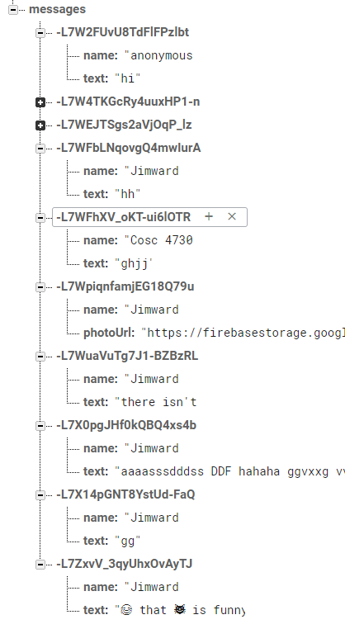
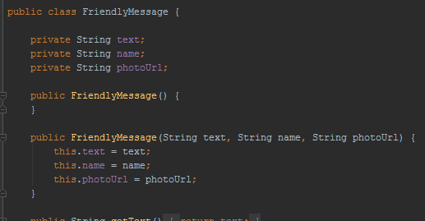
Data
The data is stored as a json object.
The L7W.. Is a unique key, that I didn't have to create.
You will need a POJO class that matches your data names

Slide 11
Database setup and use.
Setup a connection and reference.
FirebaseDatabase database = FirebaseDatabase.getInstance();
DatabaseReference dbReference = database.getReference().child("messages");
To add a new value use the push and setValue
dbReference.push().setValue( friendlyMessage);
Where friendlyMessage is a object holding the data.

Slide 12
Database notes
Firebase Realtime Database allows nesting data up to 32 levels deep, but where possible avoid nesting deep.
Also don't use json arrays.

Slide 13
FireStore Database.
Just released from Beta, Dec 2018.
For flexibity, query the database, and scalable.
Like realtime db, realtime updates and offline support.
Uses a NoSQL data model.
You have a collections, which contain documents, which can contain subcollections to build hierarchical data structures.
Allows for efficient questions, by creating shallow queries or nested questions.
https://firebase.google.com/docs/firestore/

Slide 14
Getting started.
In the console turn on firestore.
First add firestone to gradle
implementation 'com.google.firebase:firebase-firestore:18.0.1'
implementation 'com.google.firebase:firebase-core:16.0.7'
Access your database
FirebaseFirestore db = FirebaseFirestore.getInstance();
Adding data, create a HashMap
Map<String, Object> data = new HashMap<>();
data.put("back in 5 minutes", et_msg.getText().toString());
data.put("Arrow", "none");

Slide 15
Adding data
Now Add the data to the level you want it. In this case, /sign/jim/
db.collection("sign").document("Jim")
.set(data) //hashmap previously created or you can directly pass object
.addOnSuccessListener(new OnSuccessListener<Void>() {
@Override
public void onSuccess(Void aVoid) {
Log.d(TAG, "DocumentSnapshot successfully written!");
}
})
.addOnFailureListener(new OnFailureListener() {
@Override
public void onFailure(@NonNull Exception e) {
Log.w(TAG, "Error writing document", e);
}
});

Slide 16
In the console it looks like this

Slide 17
Receive the data
db.collection("users").document("Jim").get()
.addOnCompleteListener(new OnCompleteListener<DocumentSnapshot>() {
@Override
public void onComplete(@NonNull Task<DocumentSnapshot> task) {
if (task.isSuccessful()) {
DocumentSnapshot snapshot = task.getResult();
Map<String, Object> data = snapshot.getData();
TestText = String.valueOf(data.get("text"));
Arr = String.valueOf(data.get("Arrow"));
}
}
});

Slide 18
To get multiple documents from a collection
db.collection("users")
.get()
.addOnCompleteListener(new OnCompleteListener<QuerySnapshot>() {
@Override
public void onComplete(@NonNull Task<QuerySnapshot> task) {
if (task.isSuccessful()) { //iterate over the documents.
for (QueryDocumentSnapshot document : task.getResult()) {
//using document.getData() to get each one.
}
} else {
Log.w(TAG, "Error getting documents.", task.getException());
}
}
});

Slide 19
Retrieve via a listener
DocumentReference docRef = db.collection("sign").document("Jim");
docRef.addSnapshotListener(new EventListener<DocumentSnapshot>() {
@Override
public void onEvent(@Nullable DocumentSnapshot snapshot, @Nullable FirebaseFirestoreException e) {
if (e != null) { Log.w(TAG, "Listen failed.", e); return; }
//retrieve the data if it exists.
if (snapshot != null && snapshot.exists()) {
Map<String, Object> data = snapshot.getData();
TestText = String.valueOf(data.get("text"));
Arr = String.valueOf(data.get("Arrow"));
}
} });

Slide 20
References
https://console.firebase.google.com/
https://firebase.google.com/docs/
Many of the sub doc's where listed on slides.
Code lab: FriendlyChat app
https://codelabs.developers.google.com/codelabs/firebase-android/#0
Covers database, auth, invites, remote config, admob, analytics, and firebase notifications.
A short course - Firebase in a weekend
https://classroom.udacity.com/courses/ud0352 (free course)
It's dated, but still pretty good.

Slide 21
Thank
You

